Slide 1

Aviation Crash Report Safety concerns and trends

Slide 2
Aviation fatality rates are at historic low and continue to drop over time

Slide 3
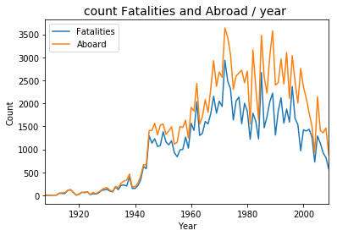
Aboard and Fatalities

Slide 4
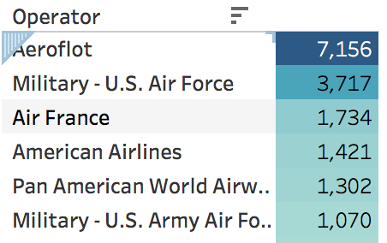
Top 5 airlines with highest fatalities
Aeroflot, the flag carrier and largest airline of Russia has had the highest number of fatalities followed by US Air Force and Air France.

Slide 5
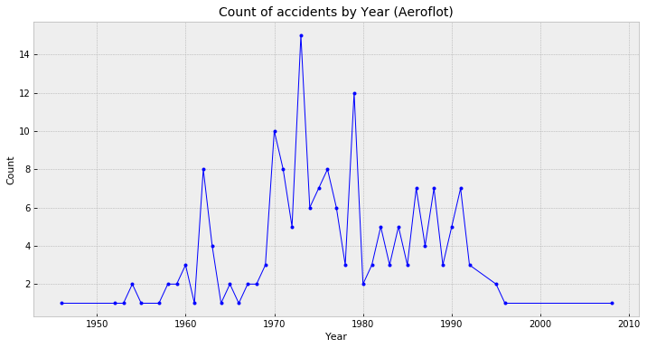
Aeroflot Accidents
The rate of Aeroflot Accidents has zeroed down in the last decade.

Slide 6
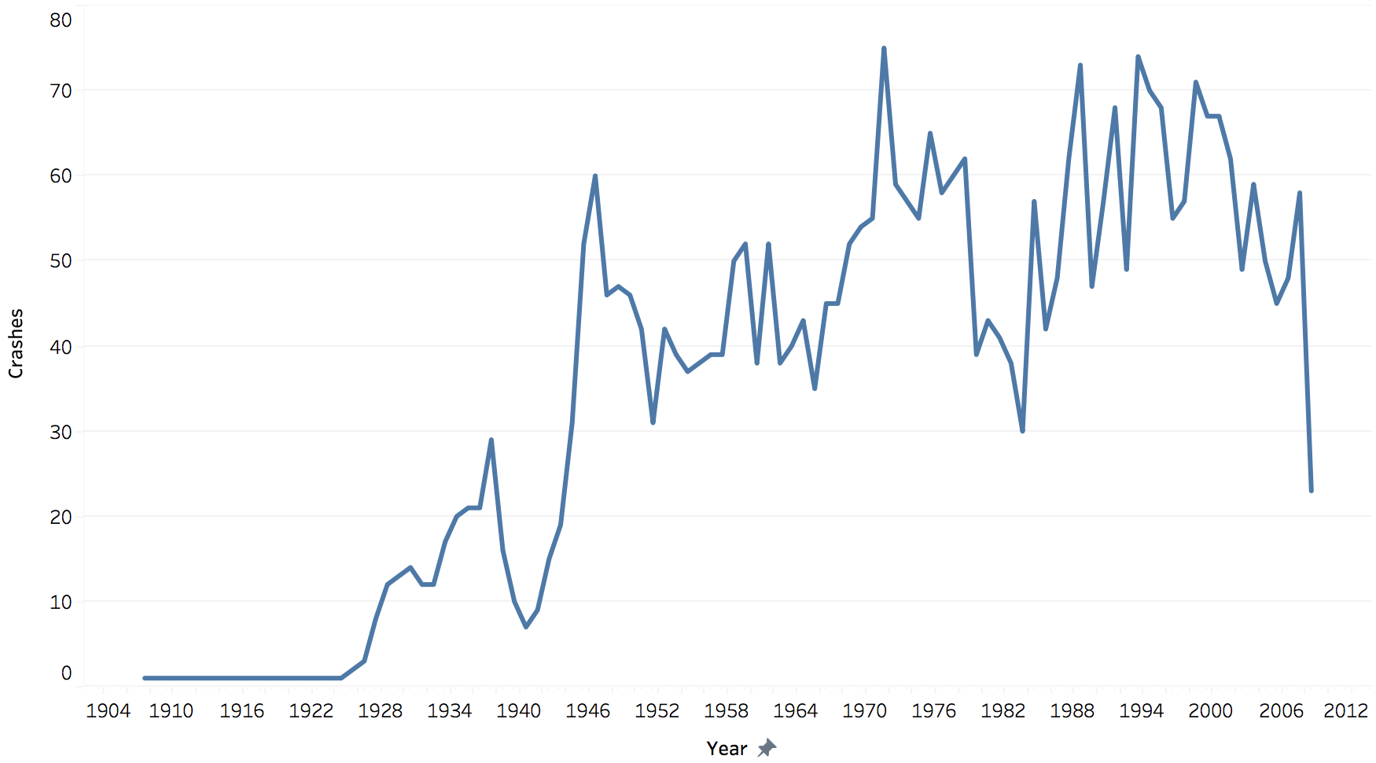
Crashes over the years

Slide 7
Popular aircraft manufacturers – Airbus vs Boeing
Airbus has recorded more fatalities compared to Boeing.

Slide 8
Popular airlines Crash report 2000 - 2014
Majority of Airlines has zero fatalities between 2000 and 2014.
With the advancement in technology, Air travel now-a-days is safer than ever!

Slide 9
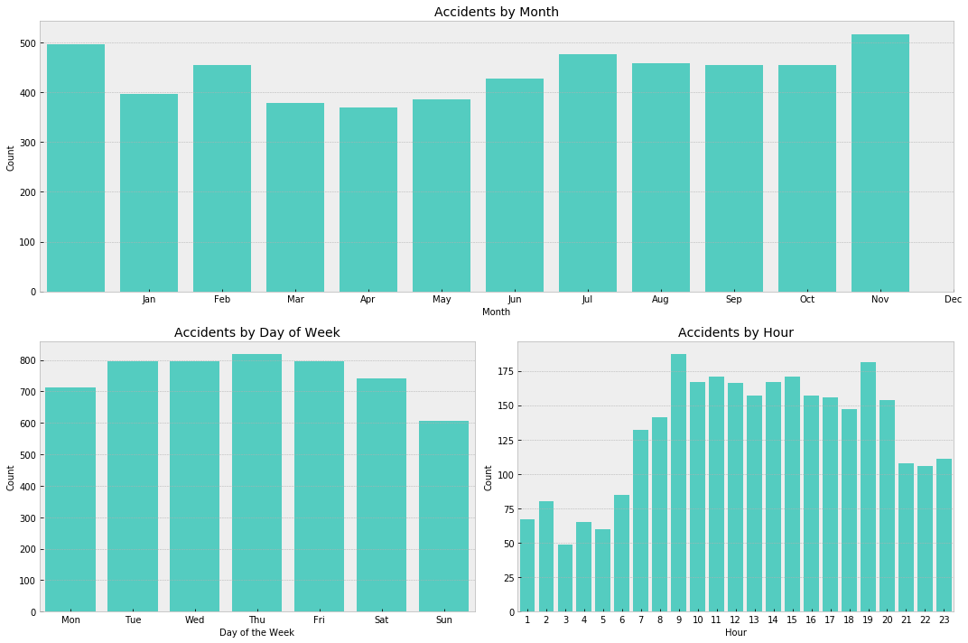
Monthly weekly and Hourly Accident data
Majority of the accidents happened between 9AM & 7PM

Slide 10
Takeaways
The rate of passenger fatalities trending down in the last decade.
As more flights take to the sky, airline crashes have been falling since Year 2006.
Popular Aircraft manufacturer Boeing is safer than Airbus.
Majority of airlines had zero fatalities.

